Slide 1

RUNGTA COLLEGE OF DENTAL SCIENCES & RESEARCH
TITLE OF THE TOPIC: COMPLEXAMALGAM RESTORATION
DEPARTMENT OF CONSERVATIVE DENTISTRY AND ENDODONTICS

Slide 2
Specific learning Objectives
At the end of this presentation the learner is expected to know ;
Core areas* | Domain ** | Category #
FAILURE OF AMALGAM RESTORATION | COGNITIVE | MUST NOW
EFFECT OF PIN ON PULP | PSYCHOMOTOR | NICE TO KNOW
AMALGAM FOUNDATION | AFFECTIVE | DESIRE TO KNOW

Slide 3
Table of Content
Mechano anatomical principles for pin placement
Principles for pin placement.
Complication during pin placement
Failure of pin retained restorations
Slot retained amalgam restorations
Amalgam foundations
Chamber retention
Restorative technique
Bonded amalgam
Conclusion
References

Slide 4
Pulpal penetration may occur
at mesiofacial corner of maxillary & mandibular first molars
Pulpal penetration treated as a pinpoint exposure
→Ca OH and prepare another hole
• If patient complains of pain after that →endodontic treatment

Slide 5
Lateral Perforation:
Occlusal to gingival attachment
Pin cut-off flush with the tooth surface.
Pin cut-off cast restoration extend gingivally..
Remove pin enlarge hole and restore with amalgam.

Slide 6
Apical to gingival attachment
Surgically remove the bone after reflecting the tissue,enlarge
pinhole, restored with amalgam
Crown lengthening and cast restoration cover the
perforation.

Slide 7
Heat generation:
Rise in temperature subsequent to the use of twist drill may be related to cutting deep channels, high rotational speeds used during channel preparations, large sized twist drills and repeated insertion of pin drills into dentin.
reduced by using 2 mm depth limiting drill and the smallest pin possible

Slide 8
Microleakage:
The use of pins conceivably aggravates the leakage problem by producing fine cracks and craze lines that behaves as communication channels with the exterior and the pulp.
Leakage with cemented pins occurs around its whole circumferance. Where as with friction locked and threaded pins occurs in semilunar pattern .

Slide 9
Microleakage can be almost eradicated under amalgam restorations by applying cavity varnish on the entire cavity surface including the pin channels.
Pin channels prepared significantly inside the dentino enamel junction also reduce the possibility of cracks extending to the dentin defects or the external surface hence reducing microleakage.
7. Microcracks:
Microcracks usually form subsequent to introduction of friction locked and threaded pins into dentin.

Slide 10
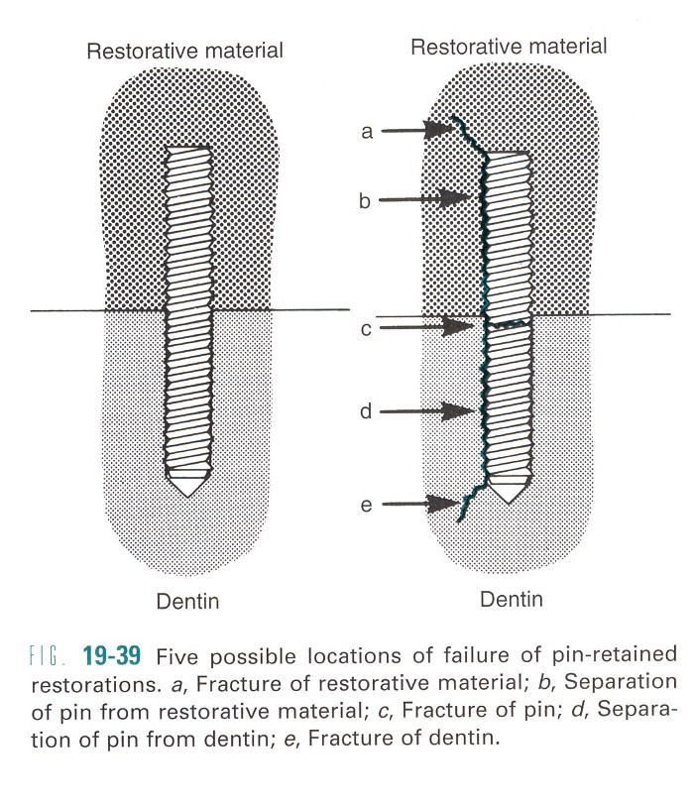
Failures of pin retained restoration:
May occur in five areas:
1. Fracture of dentin:
The solution is to reduce the area to a flat surface and re-drill a pinhole.
2. Separation of pin from dentin:
Treatment includes re cementing if it is composite restoration or performing the whole procedure again if it is amalgam restoration

Slide 11
3. Pin fractures:
Remove any remaining restorative material from the cavity preparation. Re-do the procedure and restoration again.
4. Separation of pin from restorative material:
Formation of corrosion products at the interface is the most common cause for such type of failures.
Treatment includes removal of any remaining restoratives material pins are checked for loosing and restoration done again.
5. Failure of restorative material :
The most common cause for such type of failure is an improperly retained matrix.
The treatment includes removing the remaining restorative material and tooth is restored again.

Slide 12
Effect of pins on Pulp:
Pulp responds positively to the pin and accepts its presence with out any adverse effects .
If the tooth is carious, symptomatic or a hermetic seal is not maintained under the restoration, the pulp may succumb to the injuries.
The proximity of pin channels to the pulp tend to induce pulpal responses like destruction of odontoblastic nuclei, vascular dilation, and inflammatory cell infiltration.

Slide 13
Inflammatory reactions have been observed under all three types of pins i.e. cemented ,friction locked and threaded.
The response under cemented pins is attributed to the type of cement used and its effect on pulp.
Pulpal response under friction locked and threaded pins are probably because of the microcracks generated in communication with the pulp or disruption of the odontoblastic processes.

Slide 14
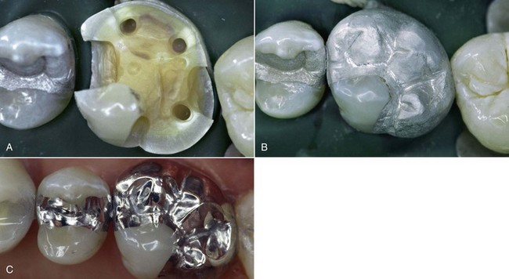
AMALGAPIN:
Introduced in 1980 by Shavell
Retention for amalgam is provided by 2-3mm deep holes placed in dentin by using round ended bur No. 1156, 1157, 1158 instead of placing pin
Amalgam is then condensed into holes and the remainder of restoration.

Slide 15
Advantages:
1.No microleakage
2. No stress in dentin.
3. No need of pins and pin system
4. Pulp irritation is avoided
Disadvantages:
More tooth structure is removed.
Shear strength of amalgam pin is less.

Slide 16
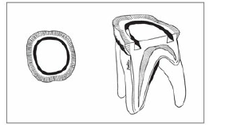
Other complex amalgam preparation
SLOT RETAINED AMALGAM RESTORATIONS
A slot is a retention groove in dentin whose length is in a horizontal plane.
Circumferential slots. Outhwaite et al introduced the circumferential slot prepared with a no. 33½ inverted cone bur
segmental slots (short segments of circumferential slots) ----- “cleats.”

Slide 17
Indications
When loss of vertical coronal height is approximately 2 to 4 mm,
then use of slots, in horizontal areas where no vertical walls remain,
In conjunction with pin retention or as an alternative to it.
(Slot retention are used in preparations with vertical walls that allow retention locks to oppose one another. Pin retention is used more frequently in preparation with few or no vertical walls. )
In short clinical crowns and in cusps that have been reduced 2-3 mm for amalgam.

Slide 18
Advantages
Less likely to create microfracture in dentin or to perforate in to pulp
Retention potential of pin and slots is similar
Disadvantages
More tooth structure is removed
more sensitive to displacement during matrix removal than are pin retained restorations

Slide 19
Slots are placed in the gingival loor of a preparation with a No. 330 bur.
In general, slots should be about 1 mm wide and 1 mm deep, should be placed in the line-angle areas of the tooth, should be 2 to 4 mm in length
0.5 to 1 mm inside the DEJ. In general, one slot per missing axial line angle should be used.
Increasing the width and depth of the slot does not increase the retentive strength of the amalgam restoration.
Slot length depends on the extent of the tooth preparation
continuous or segmented

Slide 20
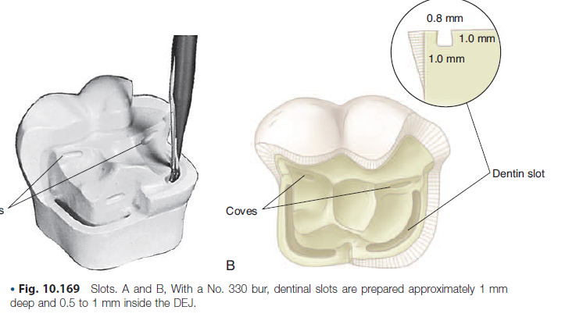

Slide 21
AMALGAM FOUNDATIONS
A foundation is an initial restoration of a severely involved tooth. It will support the final restoration.
Indications for amalgam foundations
A tooth that is severely broken down and lacks the resistance and retention forms needed for an indirect restoration. It relies mainly on secondary preparation retention features (pins, slots, cones and proximal retention locks) and somewhat on bonding benefits.
As a temporary control restoration for caries or for a tooth with questionable prognosis.
Foundations are placed in preparation for a full crown especially in endodontically treated teeth.

Slide 22
Tooth preparation
The techniques followed depend on the type of retention that is selected, having in common the axial location of the retention. These include.
Pin retention
Severely broken – down teeth with few or no vertical walls where an indirect restoration is indicated, may require a pin-retained foundation
The pinholes must be located further from the external surface of the tooth
More bending of the pins may be necessary to allow adequate axial reduction of the foundation without exposing the pins during the cast metal tooth preparation.

Slide 23
The location of the pinhole from the external surface of the tooth for foundations depends on
o The occlusogingival location of the pin
o The type of restoration to be placed ,a porcelain forced to metal or all-ceramic preparation requires more reduction than a fill gold crown.
o The type of margins to be prepared – Preparation with heavily chamfered margins at a normal occluso gingival location require pin (and slot) placement at a greater axial depth.
Proximal retention locks should be used whenever possible.
The length of the pins also must considered to permit adequate occlusal reduction without exposing the pins

Slide 24
Slot retention
Slots are placed in the gingival floor of a preparation with a No 33 ½ bur.
Foundation slots a with pins, are placed slightly more axial (father inside the DEJ)

Slide 25
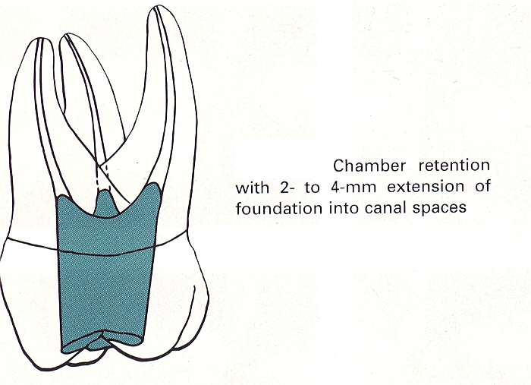
Chamber retention
For developing foundation is multi rooted endodontically treated teeth, an alternative technique has been described by Nayyar et al.
recommended only when (1) dimension to the pulp chamber is adequate to provide retention and bulk of amalgam and
(2) dentin thickness in the region of the pulp chamber is adequate to provide rigidity and strength to the tooth.

Slide 26
Kane et al demonstrated that extension into the root canal space 2 to 4 mm is recommended when the pulp chamber height is 2mm or less.
After matrix application, amalgam is then thoroughly condensed into the pulp canals, the pulp chamber and the coronal portion of the tooth.
Natural undercuts in the pulp chamber and the divergent canal provide necessary retention form

Slide 27
Resistance form is improved by gingival extension of crown structure 2mm beyond the foundation onto sound tooth structure.
This extension should have a total taper of opposing walls of less than 10⁰.
If the pulp chamber height is less than 2 mm, the use of a prefabricated post, cast post and core, pins or slots should be considered following placement of the foundation, the tooth may be prepared for the crown or on lay and indirect restoration completed.

Slide 28
Restorative technique
Use desensitizer or bonding system
Dentin bonding systems are usually recommended for extensive preparations, particularly with deep excavations, capped cusps and in weak teeth.
Application of Matrix:
Matrices used are
Toffelemiere
Auto matrix
Copper band

Slide 29
Inserting the amalgam
A high – copper alloy is strongly recommended for the complex amalgam restoration because of excellent clinical performance and high early compressive strength.
Spherical alloys have a higher early strength than the admixed alloys, and spherical alloys can be condensed quicker with less pressure to ensure good adaptation around the pins.
However, proximal contacts may be easier to achieve with admixed alloy because of their condensability and their extended working time

Slide 30
Resin bonded amalgam restoration
An amalgam restoration that has been “bonded” to the existing tooth structure through the placement of a resin dentin bonding agent followed by a viscous resin(or glass ionomer) liner into which the
fresh amalgam is condensed while the liner is still unset.

Slide 31
History
1986 by Varga et al →The first reports of experiments involving the use of adhesives under amalgam restorations were published .They assessed the bond between amalgam and human enamel as well as their effect on the marginal seal
1987, Shimizu et al studied use of an adhesive liner to reduce microleakage with or without glass ionomer base and fluoride treatment.
1988, Staninec and Holt measured tensile strength of amalgam to tooth structure as well as the microleakage at amalgam tissue interface.
They reported that amalgam can adhere to acid treated enamel and dentin through a thin coat of Panavia resin.

Slide 32
1992 Eakle et al showed the effect of bonded amalgam restoration in relation to resistance of teeth to fracture.
They reported that a tooth restored with bonded amalgam requires a significantly greater load to fracture than does a tooth restored with amalgam and no adhesive.

Slide 33
Amalgam bonding system
Used to seal underlying tooth structure and bond amalgam to enamel and dentin.
Amalgam is strongly hydrophobic, whereas enamel and dentin are hydrophilic.
Therefore the bonding system must be modified with wetting agent that has the capacity to wet both hydrophobic and hydrophilic surfaces.

Slide 34
4-methyloxy ethyl trimellitic anhydride (4-META)-based systems, ,10
MDP(10methacryloxy decyl dihydrogen phosphate) and bis GMA phosphonated ester are used frequently.
This monomer molecule contains both hydrophobic and hydrophilic end.
The HEMA acts as a vehicle which carries the tri-n-butyl borane catalyst and 4 META base into the dentin where oxygen and water supportably serves as co-catalyst for polymerization

Slide 35
Method of use and theory of amalgam bonding
After removal of carious lesion, proper isolation of the affected tooth is carried out using a rubber dam.
The tooth is etched using 33-37% phosphoric acid.
The acid is washed away by a stream of water.
The preparation should then be briefly dried, resulting in moist and glistening dentin surface.
If preparation is over dried, it may be rewetted with water or with HEMA and gluteraldehyde based desensitizer
The primer should then be applied using technique described by the manufacturer.

Slide 36
After drying the primed surface ,there should be glossy in appearance.
If it is not, primer should be reapplied until surface is glossy.
Before mixing base and catalyst from the adhesive, the amalgam should be triturated and ready to be inserted into the preparation.
Base and catalyst should be mixed, following manufacturers instructions.
After resin is placed amalgam should be condensed into the cavity and carved.

Slide 37
With subsequent application of the adhesive the formation of a ‘hybrid layer’ results and a micromechanical bond is formed to the dentin surface.
The bond to the enamel is formed through the use of auto- polymerising resin.
Bond strength for amalgam restoration →10MPa

Slide 38
This bonding mechanism actually may depend on type of amalgam used; for example, spherical amalgam alloy typically have higher bond strength than dispersed phase or admixed amalgam alloy.
The bonding system used for amalgam bonding should be essentially self cure system.
Some studies also suggest that use of dual cure bonding systems may be beneficial for bonding amalgam to dentin.

Slide 39
Bonding mechanism
Bonding interface consists of both tooth,amalgam and in between them the intervening adhesive resin.
The bond that develops between dentin and amalgam is essentially a
micromechanical bond and no chemical bonding occurs
In some system such as those containing 10MDP ,phosphate monomer can
react with tin to provide some adhesion
Dentin Interface –micromechanical (formation off hybrid layer)
Amalgam Interface –micromechanical
(interlock between viscous resin and fresh amalgam)
Weak Links – resin/amalgam interface

Slide 40
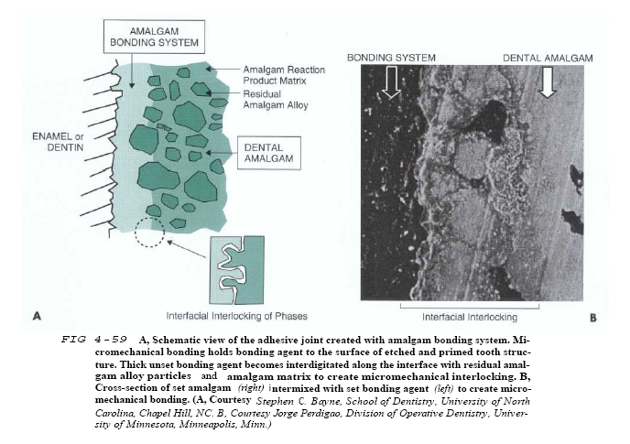

Slide 41
Indications of bonding
When remaining tooth structure after cavity preparation is weak,bonding reinforces resistance form of the restored tooth where sufficient thickness of amalgam can’t be provided.
Bonding provides auxiliary retention in deep bite cases where cervico occlusal dimension is less than normal.
In extensively carious posterior teeth as cheaper substitute for cast metal and metal ceramic restoration
As core for cast crown restoration

Slide 42
Advantages
1.Minimize or eliminate microleakage
2. Enhance traditional resistance and retention methods
3. Increase the fracture resistance of the restored tooth
4. Permit more conservative restorations
5. Decrease marginal breakdown and ditching
6. Reduced incidence off postoperative tooth sensitivity

Slide 43
Disadvantages
Extra steps and expense(both time and materials)
Technique sensitive and messy
Adhesive may stick to matrix,instruments and adjacent tooth structure
Carving more difficult
Finishing usually requires rotary instrumentation
After few years of use bond strength is reduced due to repeated thermocycling in the oral cavity.

Slide 44
TAKE HOME MESSAGE
Because of its history, the complex amalgam restorations may be the most frequently placed complex restoration.
However due to the increasing benefits of composites, the many types of auxiliary retention forms available, and the variations of tooth preparations required for complex restorations, the operator should be familiar with all of these techniques, if he or she is to use these restorations on a regular basis.

Slide 45
QUESTIONS
WHAT IS RESTORATIVE TECHNIQUE
CHAMBER TECHNIQUE
EFFECT OF PIN ON PULP

Slide 46
REFERENCES:
1. Sturdevant's Art and Science of Operative Dentistry - fourth Edition
2. Operative Dentistry - Modern theory and practice - First Edition- M.A. Marzouk
3. Text book of operative dentistry - Vimal K. Sikri
4.Fundamentals of Operative Dentistry- Summit JB- 2nd edition
5.Text book of operative dentistry → nisha carg,amit carg
6.Principles and Practice of Operative Dentistry-Gerald T. Charbeneau-Third edition.
7.Clinical operative dentistry-principles and practice→ramya Raghu,Raghu sreenivasan

Slide 47
THANK YOU

